Slide 1
FACTORS INFLUENCING INITIATION, CONTINUATION & DISCONTINUATION OF ORAL PREP AT SELECTED FACILITIES IN SOUTH AFRICA: Findings from the ACCESS Study
IAS Conference 2018: 25 July 2018
Session: PrEP Work in Progress
AUTHORS:
Diantha Pillay¹, Sarah Jenkins², Mercy Murire¹, Kayla Stankevitz³, Hasina Subedar⁴, Saiqa Mullick¹
1 Wits Reproductive Health and HIV Institute (Wits RHI), 2 Clinton Health Access Initiative (CHAI), ^{3 FHI 360,} 4 National Department of Health, South Africa

Slide 2
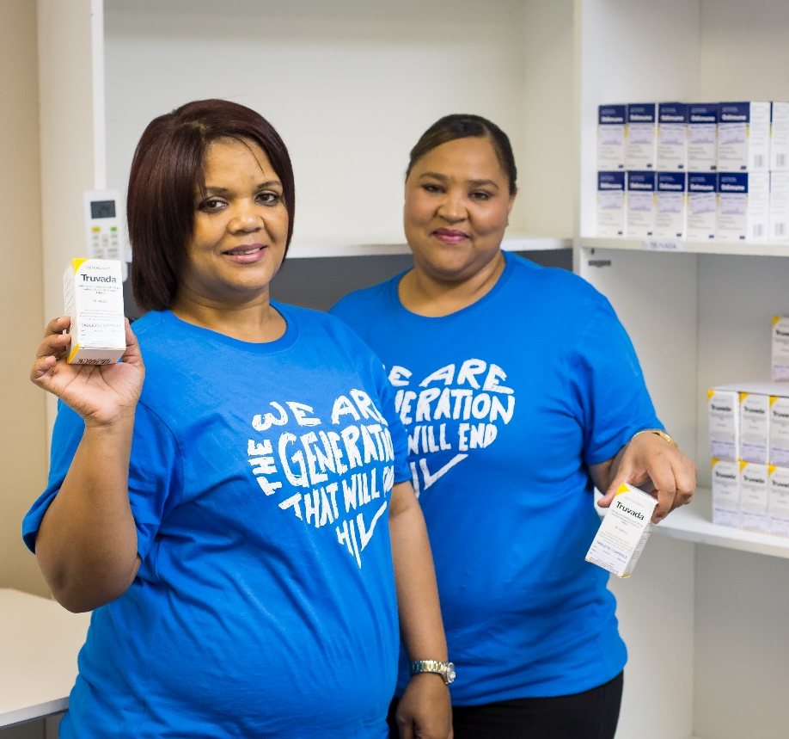
CONFLICT OF INTEREST
The author and co-authors of this presentation declare that no conflict of interest exists with regards to the development, conduct or analysis of this research

Slide 3
ACCESS:
Advancing PrEP: Comprehensive and Combined Operations Research of Services for Sex workers and men who have sex with men
Collaborative effort between OPTIONS (Wits RHI) and Prevention Market Manager in support of NDoH PrEP roll-out

Slide 4
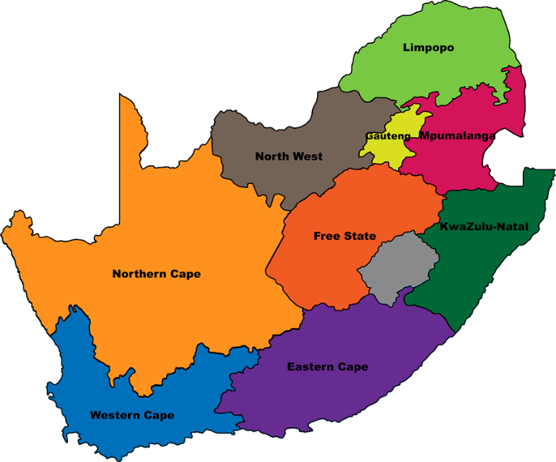
Study background and site selection
South Africa: June 2016 PrEP Launch for SW and April 2017 for MSM
ACCESS was conducted at 9 sites across 4 provinces:
NSA Hoedspruit (Rural)
NSA Musina (Rural)
June 2017 – PrEP available at 16 facilities in 6 Provinces
PHRU Soweto (Peri-urban)
WRHI Tshwane (Urban)
ANOVA Health4Men Yeoville (Urban)
OUT Ten81 Pretoria (Urban)
9 facilities selected for operations research
Operations research is needed to learn from national PrEP rollout and improve program implementation
THCA eThekwini (Urban)
THCA uMkhanyakude (Urban)
ANOVA Health4Men Woodstock (Urban)

Slide 5
Study Objectives & Methodology
Clients
Providers & Systems
Knowledge Sources
Assess service provider knowledge, attitudes, and practiced behaviours around oral PrEP delivery
Examine the effectiveness of oral PrEP marketing and communication mechanisms
Examine factors affecting clients’ decision to initiate, continue, and/or stop PrEP use
Cross-sectional descriptive study

Slide 6
Client sample selection and size
9 SITES
HIV negative individuals accessing services (18 years and above) at fixed or mobile sites
Survey
94
Current Users
317 Clients Enrolled
156
Female
Sex
Workers
149
Heard
of PrEP
57 Current Users
43 Past Users
49 Never Users
In-depth Interview
After data cleaning
80
MSM
77
Heard
of PrEP
22 Current Users
31 Past Users
24 Never Users
80
Past Users
29
Clients Enrolled
299
Effective Sample
63
Other
34
Heard
of PrEP
15 Current Users
6 Past Users
13 Never Users
17 current users
3 past users
9 never users
86 Never Users

Slide 7
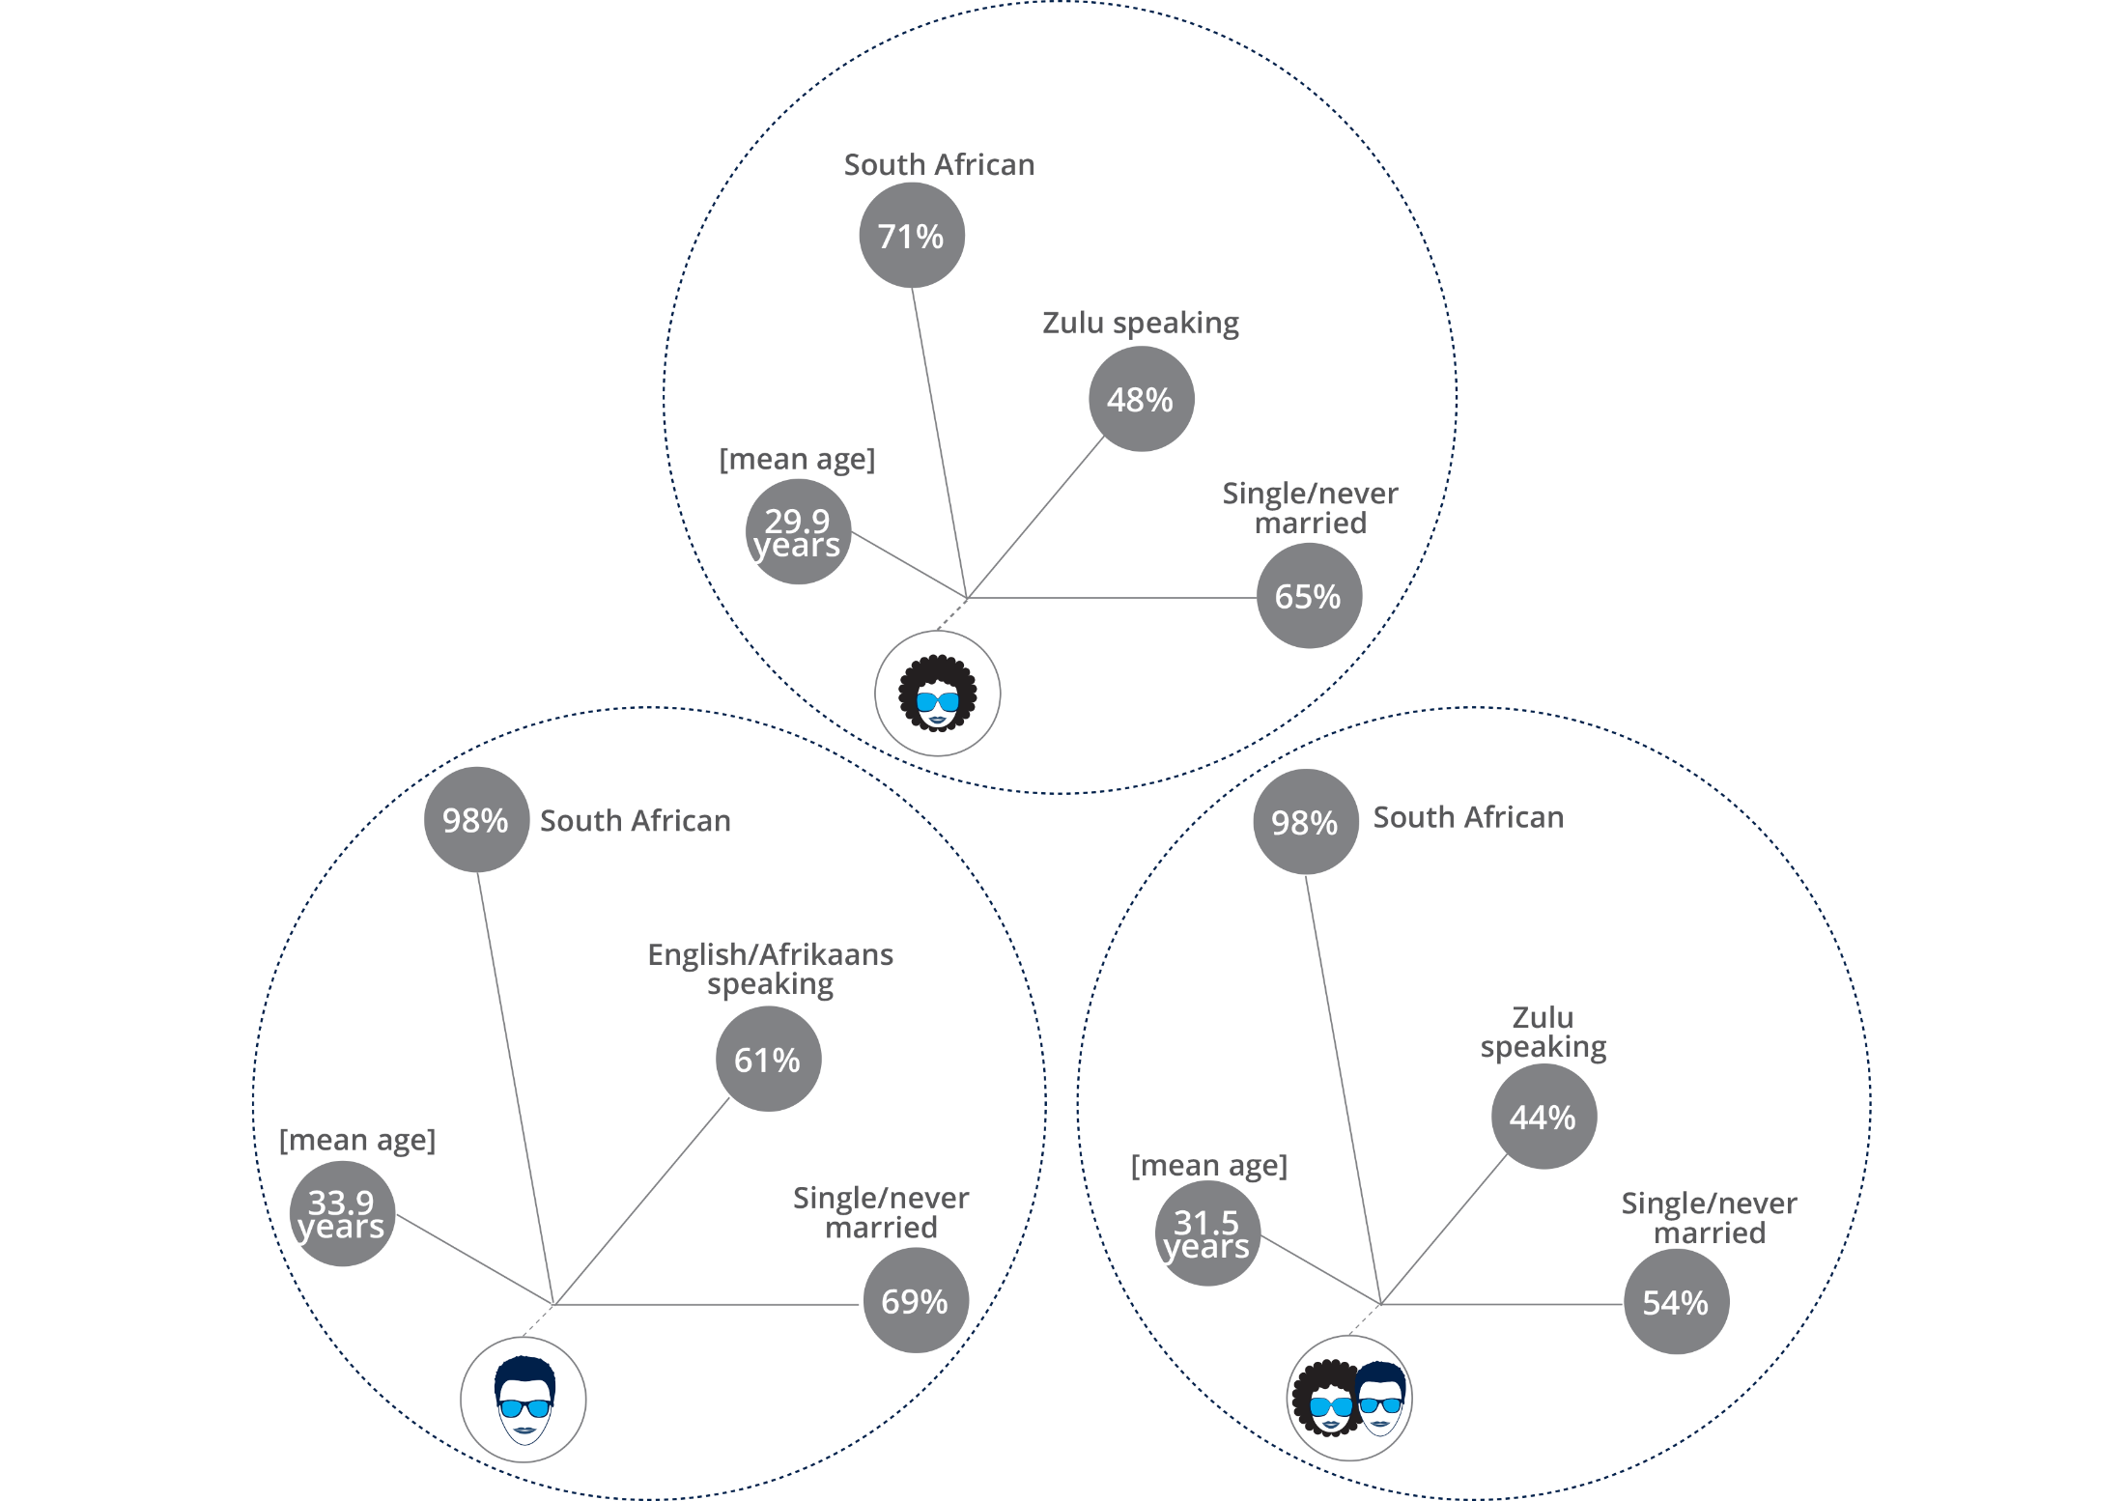
Participant demographics
156 FSW
80 MSM
63 Other

Slide 8
Missed opportunities to provide PrEP
Clients who have never used PrEP
Declined
Never Been Offered
Starting Today
Reason for decline (n=24):
12 side effects
3 Stigma
2 Clinic too far
1 Family Disapproved
1 Monogamous
5 Other
Reason for decline (n=7):
2 Side Effects
1 Clinic too far,
1 Monogamous
3 Other
Reason for decline (n=3):
1 I don’t like pills
1 I am undecided
1 Has one faithful sexual partner
Missed Opportunity: Out of 78 clients, 44 (56%) had never been offered PrEP of which 23 (52%) perceived themselves at risk of HIV; 91% (n=21) had tested for HIV

Slide 9
Sex and Risk: A driver for PrEP uptake
Reasons for Initiation amongst Current and Past Users of PrEP
Out of the 53 MSM current and past users, 35 did not understand this question and responses were invalid and excluded from the analysis of this question
Sex and Risk: Irrespective of key population type the primary reason for initiating PrEP was being sexually active
Notes:
Clients were asked a single response question about reasons for why they had initiated on PrEP. We found, the primary reason for initiation irrespective of key population related to perceiving risk associated with sexual activity.
Qualitative interviews suggested additional drivers to start PrEP and these include:
Receiving information about PrEP or encouragement to try PrEP from health care providers, family members, or peers
Wanting additional protection against HIV beyond their current HIV prevention practices
Other reasons for starting PrEP include identifying as a sex worker, need for HIV prevention, partners or clients with unknown status and being in a relationship with someone with a known positive status

Slide 10
Sex and Risk: A driver to continue on PrEP
Reasons for Continuation amongst Current Users of PrEP
Sex and Risk: Risk perceived from sexual activity remains as a prominent reason to continue on PrEP, irrespective of key population
* Multiple responses allowed

Slide 11
Side Effects: A major reason for
stopping PrEP
Reasons for Discontinuation of PrEP among Past Users of PrEP
Side effects were primarily identified as gastro-intestinal upsets, such as nausea and vomiting in FSW, and dizziness, nausea, and headaches in MSM.
* Multiple responses allowed

Slide 12
Side effects affects daily life of past users
(n=55)
(n=45)
(n=54)
(n=30)
(n=16)
(n=8)
(N=91)
(N=58)
(N=49)
(N=55)
(N=52)
(N=54)
Tolerating Side Effects: There could be distinct differences between current and past users in the way in which they tolerate side effects

Slide 13
Management of side effects not well covered in counselling sessions
Client recall of topics covered in counselling with provider

Slide 14
Summing it all up…
Missed Opportunities to offer PrEP
RISK
SAFETY
Lack of uptake of PrEP in this sample can be attributed to clients not being offered PrEP along with concerns over side effects
This highlights missed opportunities to offer PrEP to clients who perceive HIV risk
Knowing your risk drives PrEP initiation & Continuation
Initiation is largely driven by perceiving risk associated with sexual activity
Side effects influence discontinuation
Clients who continue on PrEP appear to tolerate side effects differently from those that discontinue
Counselling appears to cover the possibility of side effects but to a lesser degree the management of side effects

Slide 15
Where to from here…
Hello!
Offering PrEP to those at risk
Enable providers to identify clients at risk of HIV through client-centred counselling
In South Africa, revision of clinical and counselling training underway
Counselling on managing side effects
Provide more focused counselling to set expectations for side effects and equip users with methods to manage them.
Clinical and counselling training revision will stress importance of counselling on both side effects as well as side effect management
Let’s talk
I value…
Understanding provider perceptions
Analyse provider in-depth interview
Convene workshop with providers

Slide 16
Acknowledgments
This program is made possible by the generous assistance from the American people through the U.S. Agency for International Development (USAID) in partnership with PEPFAR under the terms of Cooperative Agreement No. AID-OAA-A-15-00035. The contents do not necessarily reflect the views of USAID or the United States Government.
COUNSELLING
We would like to acknowledge the South African National Department of Health for their support throughout conducting this study.
We would like to acknowledge Wits RHI, ANOVA Health for Men, North Star Alliance, TB HIV Care, PHRU, Out Ten 81for allowing access to the sites and to the providers and clients who participated in the study.
We would like to acknowledge the data collectors who were contracted from Freshly Ground Insights (FGI), as well as FGI leadership.
We would like to acknowledge the ACCESS study team from Wits RHI, Prevention Market Manager (AVAC-CHAI) and FHI 360.

Slide 17
Thank you for your attention
COUNSELLING
COUNSELLING
FOR FURTHER INFORMATION, CONTACT THE PRESENTER, DIANTHA PILLAY AT: DPILLAY@WRHI.AC.ZA

